Slide 1


KADI SARVA VISHWAVIDYALAYA B.P.COLLEGE OF COMPUTER STUDIES S.V.INSTITUTE OF COMPUTER STUDIES
BCA SEMESTER –V
BCA - 507
“MyMento”
Project Phase – I GROUP NO:- A-5
NO. | ENROLLMENT NO. | NAME | ROLL NO. | EXAM NO.
1 | 22BCA53170 | SINGH AYUSH | 22A161
2 | 22BCA53208 | RAVAL MOHIT | 22A156
3 | 22BCA53027 | DARAJI TAKSHAL | 22A109
4 | 22BCA53083 | PANCHAL DEVARSH | 22A130

Slide 2
INDEX
Sr No. | TOPIC | SLIDE NO
1 | TASK 1
 | 1.1) PROJECT TITLE.
 | 1.2) PROJECT DEFINITION.
 | 1.3) TECHNOLOGY USED (FRONT END / BACK END).
2 | TASK 2
 | 2.1) PROJECT SCOPE AND OBJECTIVE.
 | 2.2 ) STUDY OF EXISTING SYSTEM.
 | 2.3) ADVANTAGES OF EXISTING SYSTEM
 | 2.4) DISADVANTAGES OF EXISTING SYSTEM
 | 2.5) OPERATION LEVEL PROBLEM
 | 2.6) TECHNICAL LEVEL PROBLEM
 | 2.7) INFORMATION LEVEL PROBLEM
3 | TASK 3
 | 3.1) PROPOSED SYSTEM
 | 3.2) PROPOSED SYSTEM ADVANTAGES
 | 3.3) PROPOSED SYSTEM DISADVANTAGES
 | 3.4) SRS INCLUDING FUNCTIONAL REQUIREMENT

Slide 3
Sr No. | TOPIC | SLIDE NO
 | 3.5) SRS INCLUDING NON FUNCTIONAL REQUIREMENT
 | 3.6) OPERATIONAL FEASIBILITY STUDY
 | 3.7) TECHNICAL FEASIBILITY STUDY
 | 3.8) ECONOMICAL FEASIBILITY STUDY
 | 3.9) SCHEDULED FEASIBILITY STUDY
4 | TASK 4
 | 4.1) PROPOSED SYSTEM MODULE
 | 4.2) SCREEN DESIGNING
5 | TASK 5
 | 5.1) ENTITY RELATIONSHIP DIAGRAM
 | 5.2) DATA FLOW DIAGRAM
6 | TASK 6
 | 6.1) DATA DICTIONARY

Slide 4

TASK 1
1.1) PROJECT TITLE

Slide 5
1.2) PROJECT DEFINITION
Definition :
Mymento is a web-based platform designed to manage and display student information, including academic records, attendance, and mentor details. It allows secure access for students, faculty, and parents, ensuring data integrity and streamlined communication while preventing unauthorized changes to critical information.

Slide 6
1.3) TECHNOLOGY USED
Front End : 1) HTML 2) CSS 3)JAVASCRIPT
Back End : 1) MYSQL 2) PYTHON

Slide 7
TASK 2
2.1) PROJECT SCOPE AND OBJECTIVE
1. User Management
Student Access:
- View and update personal info, marksheets, attendance, and mentor details.
Admin Access (Faculty):
- Manage student details, academic records, attendance, and mentors.
2. Data Management
- Store and update personal info, academic records, and attendance.
3. Security and Permissions
- Students view and update their details.
- Admins control data changes.

Slide 8
4. Communication and Notifications
- Display mentor details.
- Notify users of updates.
5. Reporting and Analytics
- Generate performance and attendance reports.
- Analyze trends.
6. User Interface and Experience
- User-friendly dashboards.
- Mobile-friendly design.
7. Scalability and Maintenance
- Handle growth in users and data.
- Regular updates and maintenance.

Slide 9
2.2) STUDY OF EXISTING SYSTEM
The current system uses physical mentoring books managed by mentors (admins). It requires physical storage, manual data entry, and in-person access, making it prone to human error and data loss. Communication and updates are manual, with no automated notifications. Generating reports and analyzing trends is time-consuming. Accessibility is limited, and scalability is challenging as student numbers grow. Maintenance involves physical upkeep and protection. Transitioning to a digital system like Mymento would improve accuracy, efficiency, and accessibility.

Slide 10
2.3) ADVANTAGES OF EXISTING SYSTEM
Simplicity and Accessibility: Physical records are easy to manage and access without the need for technical expertise or digital tools. Anyone familiar with traditional record-keeping can quickly retrieve information.
No Dependency on Technology: Since it is a physical system, there’s no risk of data loss due to system crashes, hacking, or technological failures like software bugs or hardware breakdowns.
Personal Interaction: A physical record-keeping system often allows for more personal involvement by faculty, which can help in understanding the student’s needs and tracking their progress closely.
Data Control: Faculty has direct control over the data, ensuring that sensitive student information is handled with care and protected from unauthorized access that could happen in a digital system.

Slide 11
Immediate Reference: In cases where digital systems are not practical or are under maintenance, physical books allow for immediate referencing of key student details without delay.
Low Initial Cost: Maintaining physical records can sometimes be more cost-effective in institutions where setting up or maintaining a digital infrastructure is expensive.
Offline Availability: Physical records are accessible even in areas with limited or no internet connectivity, making them reliable in environments where digital infrastructure is weak.

Slide 12
2.4) DISADVANTAGES OF EXISTING SYSTEM
Time-Consuming: Entering and retrieving data manually takes a significant amount of time, especially when handling a large number of students. This can slow down processes like report generation or updating records.
Prone to Errors: Manual entry increases the likelihood of human errors, such as misplacing documents, incorrect data entry, or omissions, which can compromise the accuracy of records.
Difficult to Update: Updating physical records can be cumbersome, especially when changes need to be made frequently. Each update might require manual corrections or new entries, leading to inconsistencies.
Storage Space Issues: As the number of students grows, storing all the physical documents becomes a challenge. Physical records take up space and require proper organization to avoid clutter and confusion.
Security Risks: Physical documents are vulnerable to theft, loss, or damage due to accidents such as fires, floods, or mishandling. Securing sensitive data physically is more challenging compared to encryption or digital security methods.

Slide 13
Limited Accessibility: Accessing data requires physically being present at the storage location, which limits the flexibility for faculty or administration to access information remotely or outside working hours.
No Backup: Unlike digital systems, physical records lack an automatic backup mechanism. If records are lost or damaged, they cannot be easily restored.
Inefficiency in Data Sharing: Sharing physical documents between departments or individuals can be slow and cumbersome, often requiring duplication and increasing the risk of misplacing information.
Environmental Impact: The need for paper, printing, and storage contributes to resource wastage and has a negative impact on the environment due to paper consumption.
Limited Data Analysis: Physical records make it difficult to analyze data efficiently. Unlike digital systems, which can generate reports, trends, or student progress automatically, manual analysis requires additional time and effort.

Slide 14
2.5) OPERATION LEVEL PROBLEM OF PROPOSED SYSTEM
User Training:
- Faculty and students may need training to use the new system effectively.
User Resistance:
- Resistance to change from a familiar physical system to a digital one.
Routine Maintenance:
- Regular system updates and maintenance are required to ensure smooth operation.
Support Services:
- Need for a dedicated support team to handle user issues and system troubleshooting.
Compliance:
- Ensuring the system complies with institutional policies and regulations.
User Training:
- Faculty and students may need training to use the new system effectively.
User Resistance:
- Resistance to change from a familiar physical system to a digital one.
Routine Maintenance:
- Regular system updates and maintenance are required to ensure smooth operation.
Support Services:
- Need for a dedicated support team to handle user issues and system troubleshooting.
Compliance:
- Ensuring the system complies with institutional policies and regulations.

Slide 15
Data Entry:
- Initial and ongoing data entry requires accuracy and diligence.
Access Control:
- Managing user permissions and access rights can be complex.
Monitoring:
- Continuous monitoring of system performance and usage.
Resource Allocation:
- Allocation of resources for system upkeep and improvement.
Feedback Loop:
- Implementing a feedback system for continuous improvement based on user experiences.

Slide 16
2.6) TECHNICAL LEVEL PROBLEM OF PROPOSED SYSTEM
System downtime and software bugs can disrupt access and functionality. Data migration from physical books is challenging. Scalability issues may arise with increased users. Integration with existing systems can be difficult. Performance must be optimized for peak usage times. Security vulnerabilities pose risks of cyberattacks and data breaches. Reliable backup and recovery solutions are essential. User authentication needs to be secure and efficient. Continuous technical support is necessary to address issues and assist users.

Slide 17
2.7) INFORMATION LEVEL PROBLEM OF PROPOSED SYSTEM
Ensuring data accuracy and consistency is crucial, along with protecting privacy from unauthorized access. There’s a need to avoid redundancy and maintain data integrity while managing appropriate access levels. Data retention policies must be established, and regular backups are essential to prevent loss. Efficient data retrieval and accurate analysis are necessary for meaningful insights and reporting.

Slide 18
TASK 3
3.1) PROPOSED SYSTEM
The MyMento platform is a web-based system designed to manage student information, including academic records, attendance, and mentor details.
It ensures secure access for students, faculty, and parents, while also streamlining communication and maintaining data integrity
Facilitate streamlined communication between students, faculty, and mentors.
Automate notifications for important updates and events.
Provide reporting and analytics tools for performance and attendance tracking

Slide 19
3.2) PROPOSED SYSTEM ADVANTAGES
Efficiency: Automated data entry and updates save time and reduce manual work.
Accuracy: Reduces human errors in record-keeping.
Accessibility: Provides 24/7 access to information for students and faculty.
Security: Ensures data integrity with controlled access.
Scalability: Capable of handling growing data and user numbers

Slide 20
3.3) PROPOSED SYSTEM DISADVANTAGES
Initial Setup Cost: High development and implementation expenses.
Learning Curve: Faculty and students may need time to adapt.
Data Security Risks: Potential vulnerabilities to cyberattacks.
Dependence on Internet: Requires a stable connection for access.
Maintenance: Requires regular updates and ongoing system upkeep.
Privacy Concerns: Risk of unauthorized access to sensitive student information.

Slide 21
3.4) SRS INCLUDING FUNCTIONAL REQUIREMENT
User Management:
Student Access: View personal information, marksheet , attendance, and mentor details.
Admin Access (Faculty):Manage student details, academic records, attendance, and mentors.
Data Management:
Store and update personal information, academic records, and attendance.
Security and Permissions:
Students can view only their details.
Admins have control over data changes.
Communication and Notifications:
Display mentor details.
Notify users of updates.

Slide 22
3.5) SRS INCLUDING NON-FUNCTIONAL REQUIREMENT
Scalability:
Ability to scale horizontally and vertically as the user base grows.
Maintainability:
Regular updates and maintenance for smooth operation.
Modular design to allow easy upgrades and modifications.
Portability:
Compatibility with various devices and operating systems
Compliance:
Adherence to educational data privacy regulations.

Slide 23
3.6) TECHNICAL FEASIBILITY STUDY
Technology Stack: The proposed system will use modern web technologies (e.g., HTML, CSS, JavaScript) and a robust backend (e.g. Python) with a secure database (e.g., MySQL).
Infrastructure: The system will be hosted on reliable cloud platforms (e.g., AWS, Azure) with scalability features.
Integration: The system will integrate with existing academic systems and databases.
3.7) OPERATIONAL FEASIBILITY STUDY
User Training:Training sessions for faculty and students to ease the transition from physical to digital systems.
Support:A dedicated support team for technical issues and troubleshooting.
Routine Maintenance:Regular system updates and maintenance.

Slide 24
3.8) ECONOMICAL FEASIBILITY STUDY
Initial Costs: The development and implementation of the system require significant upfront investment. This includes software development, hardware setup, and integration with existing systems.
Ongoing Costs: These include regular maintenance, cloud hosting (e.g., AWS, Azure), support services, and periodic updates to ensure the system runs smoothly .
Cost-Benefit Analysis: The long-term benefits of the system, such as increased efficiency, improved data accuracy, reduced manual labor, and enhanced user satisfaction. The system also saves on physical resources, reducing paperwork and storage needs.
Scalability: The system is designed to scale with the increasing number of users, ensuring that future costs will be managed effectively as the user base grows .

Slide 25
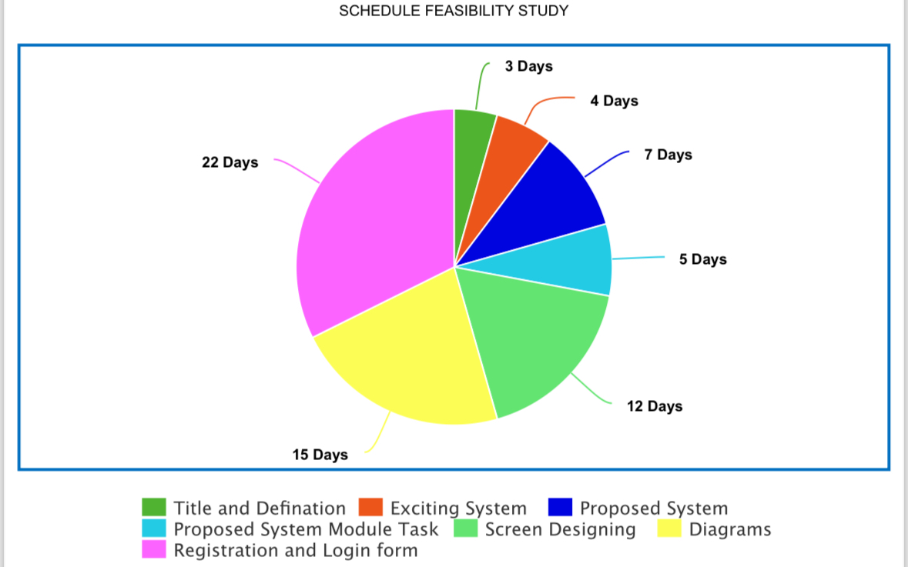
3.9) SCHEDULE FEASIBILITY STUDY
Existing System

Slide 26
TASK 4
4.1) PROPOSED SYSTEM MODULE
Login:-
Input:User credentials (username and password).
Process:Verify the credentials with the stored database information.
Output:Access granted to the system or prompt to retry.
Registration:-
Input:Student information (name, email, student ID, etc.).
Process:Authenticate the information and create a new account in the database.
Output:Registration successful or retry message.
Attendance Tracking:-
Input:Student attendance details (date, class, status).
Process:Record the attendance in the database and update records.
Output:Attendance data saved or error message.

Slide 27
Performance Tracking:-
Input:Academic scores and progress reports.
Process:Update and store the performance data for each student.
Output:Generate performance reports or notification for missing data.
Notification:-
Input:Details of low attendance, mentoring book updates, or other system alerts.
Process:Send notifications to users about low attendance or mentor updates.
Output:Notifications sent successfully or retry.

Slide 28

4.2) SCREEN DESIGNING
1) LOGO

Slide 29

2) MAIN PAGE

Slide 30
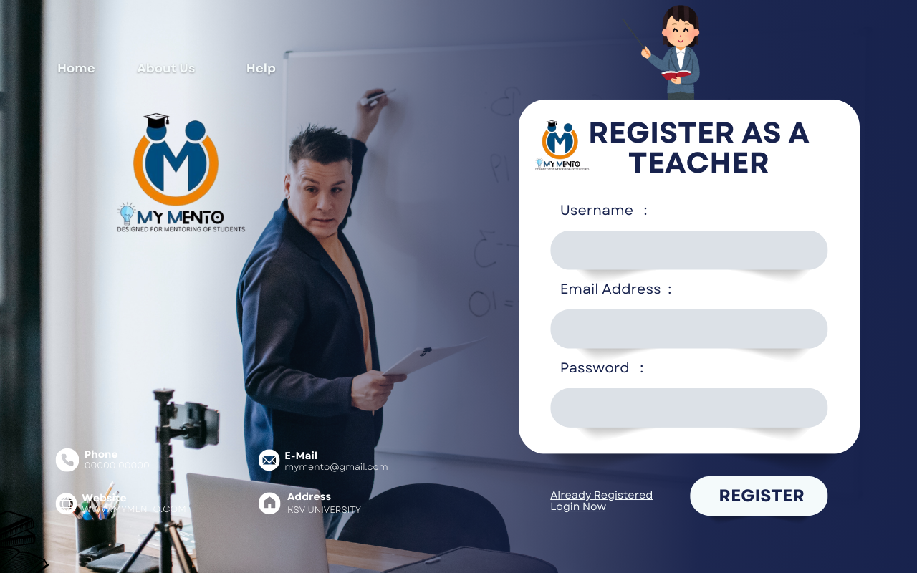
3) TEACHER REGISTER PAGE

Slide 31
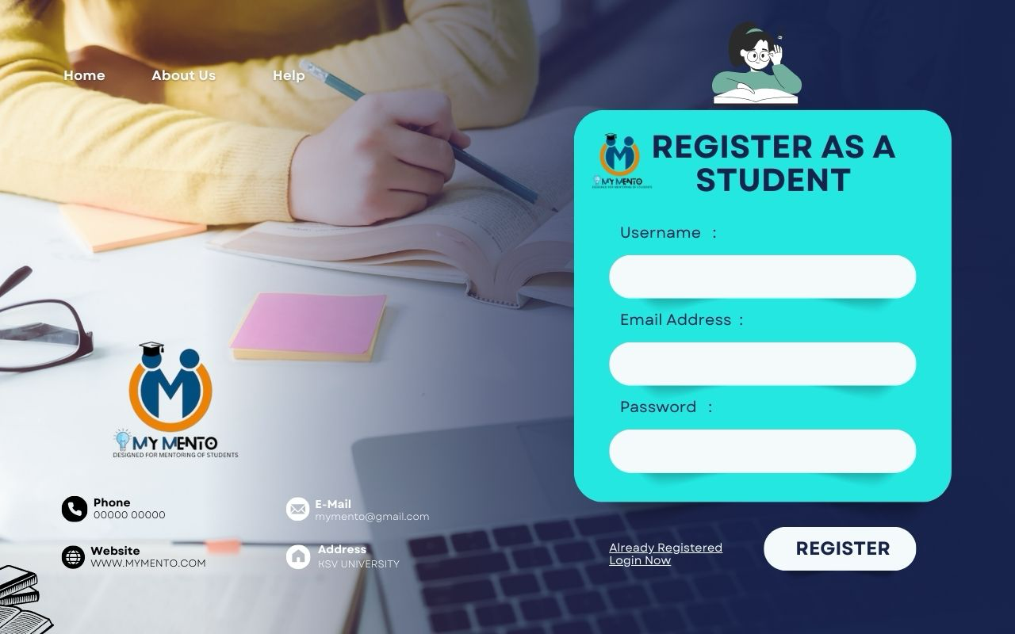
4) STUDENT REGISTER PAGE

Slide 32
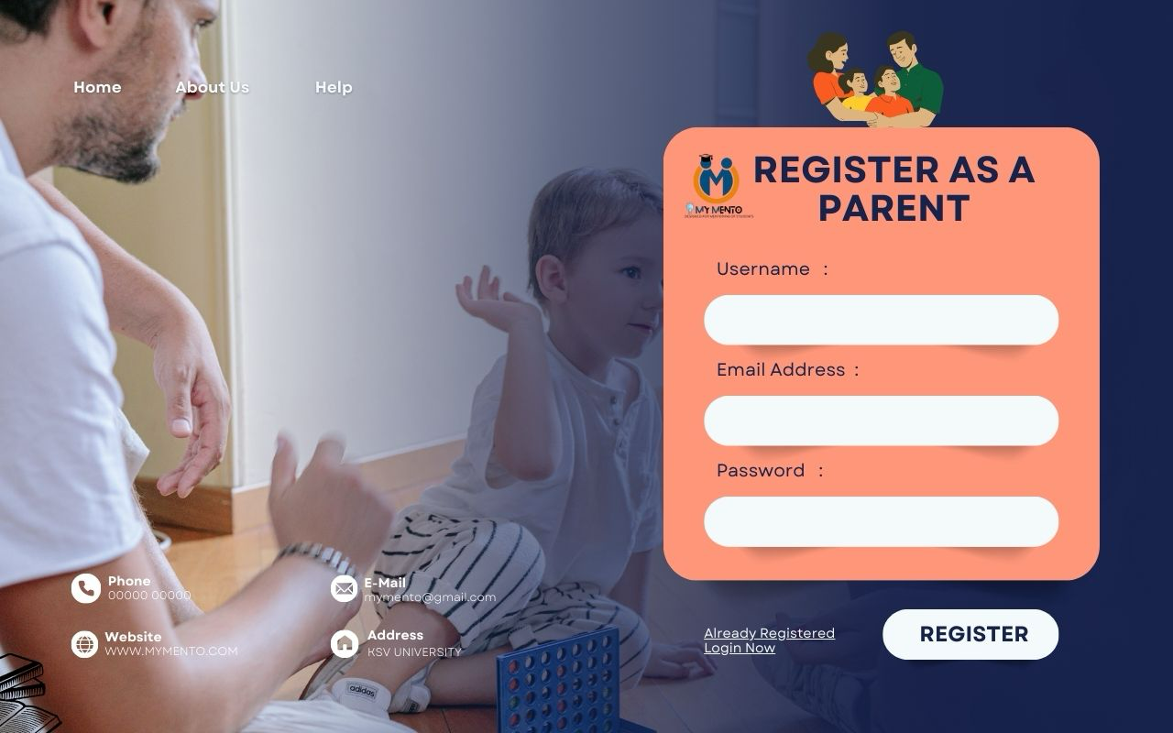
5) PARENT REGISTER PAGE

Slide 33
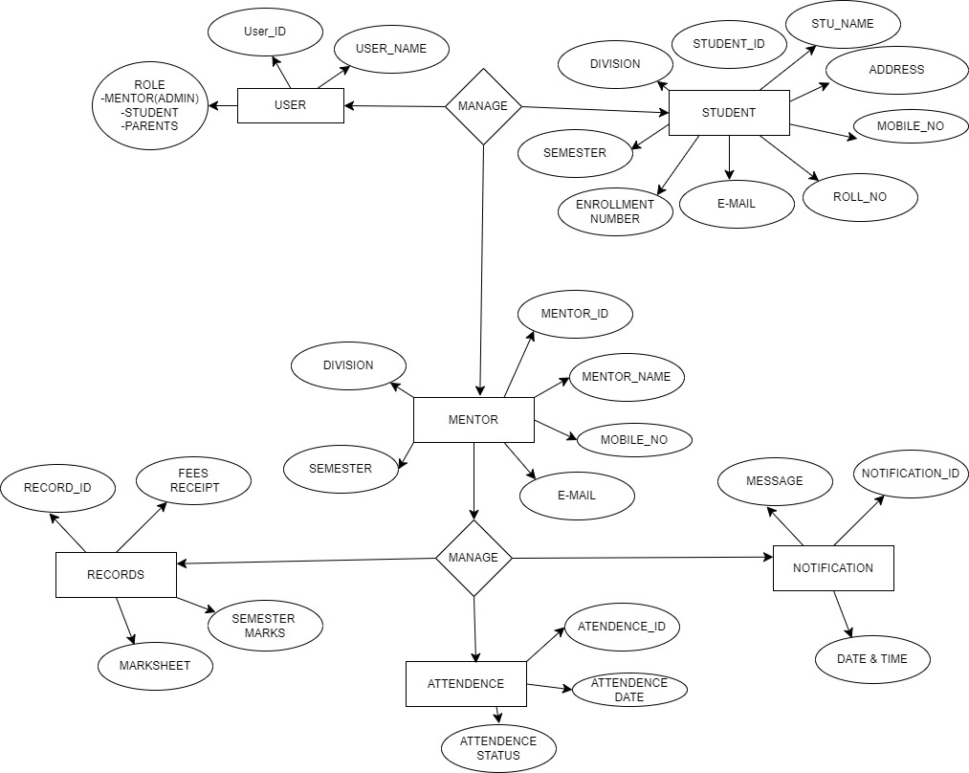
TASK 5
5.1) ENTITY RELATIONSHIP DIAGRAM

Slide 34
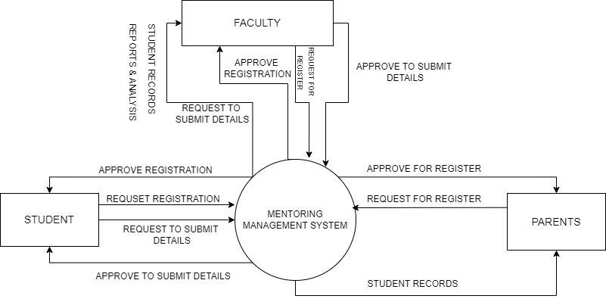
5.2) DATA FLOW DIAGRAM
Context Level
0.0

Slide 35
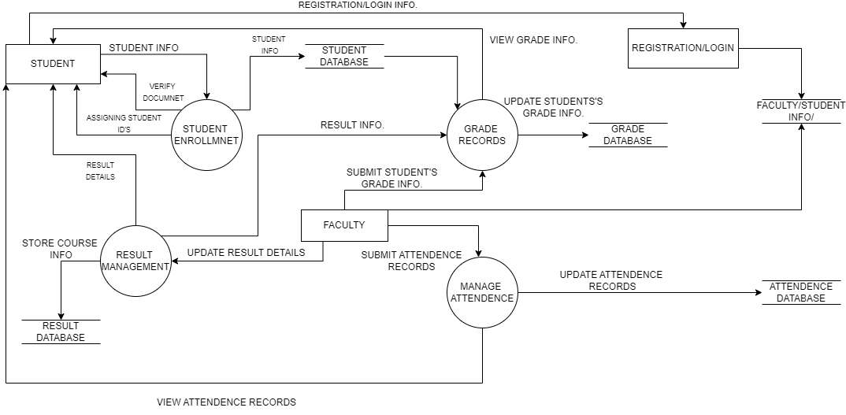
1st Level DFD
1.1
1.2
1.3
1.4

Slide 36
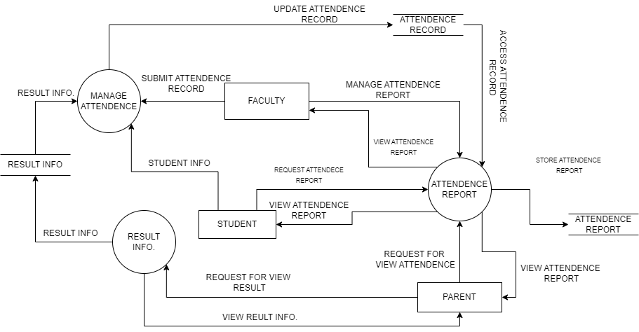
2nd Level DFD
2.1
2.2
2.3

Slide 37
TASK 6
6.1) DATA DICTIONARY
1. USER TABLE
NO | FIELD NAME | DATA TYPE | SIZE | CONSTRAINT
1 | USER_ID | VARCHAR | 20 | PRIMARY KEY
2 | USER_NAME | CHAR | 20 | NOT NULL
3 | ROLE - MENTOR(ADMIN) -STUDENT - PARENTS | VARCHAR | 20 | NOT NULL

Slide 38
2. STUDENT TABLE
NO | FIELD NAME | DATATYPE | SIZE | CONSTRAINT
1 | STUDENT_ID | VARCHAR | 10 | PRIMARY KEY
2 | STU_NAME | VARCHAR | 20 | NOT NULL
3 | ADDRESS | VARCHAR | 50 | NOT NULL
4 | MOBILE NUMBER | NUMBER | 10 | NOT NULL
5 | E-MAIL | VARCHAR | 20 | UNIQUE
6 | ROLL_NO | VARCHAR | 20 | NOT NULL
7 | ENROLLMENT_NO | VARCHAR | 20 | NOT NULL
8 | SEMESTER | NUMBER | 20 | NOT NULL
9 | DIVISION | CHAR | 10 | NOT NULL
10 | USER_ID | VARCHAR | 20 | FOREIGN KEY

Slide 39
3. MENTOR TABLE
NO | FIELD NAME | DATATYPE | SIZE | CONSTRAINT
1 | MENTOR_ID | VARCHAR | 10 | PRIMARY KEY
2 | MENTOR_NAME | VARCHAR | 20 | NOT NULL
3 | MOBILE NUMBER | NUMBER | 10 | NOT NULL
4 | E-MAIL | VARCHAR | 20 | UNIQUE
5 | SEMESTER | NUMBER | 20 | NOT NULL
6 | DIVISION | CHAR | 10 | NOT NULL
7 | USER_ID | VARCHAR | 10 | FOREIGN KEY

Slide 40
4. ATTENDANCE TABLE
NO | FIELD NAME | DATATYPE | SIZE | CONSTRAINT
1 | ATTENDENCE_ID | VARCHAR | 10 | PRIMARY KEY
2 | USER_ID | VARCHAR | 20 | FOREIGN KEY
3 | ATTENDENCE_DATE | DATE AND TIME | 10 | NOT NULL
4 | ATTENDENCE_STATUS | VARCHAR | 20 | NOT NULL

Slide 41
5. RECORD TABLE
NO | FIELD NAME | DATATYPE | SIZE | CONSTRAINT
1 | RECORD_ID | VARCHAR | 10 | PRIMARY KEY
2 | FEES RECEIPT | VARCHAR | 20 | NOT NULL
3 | SEMESTER MARKS | NUMBER | 10 | NOT NULL
4 | MARKSHEET | VARCHAR | 20 | UNIQUE
5 | USER_ID | VARCHAR | 10 | FOREIGN KEY
NOT NULL

Slide 42
6. NOTIFICATION TABLE
NO | FIELD NAME | DATATYPE | SIZE | CONSTRAINT
1 | NOTIFICATION_ID | VARCHAR | 10 | PRIMARY KEY
2 | MESSAGE | VARCHAR | 20 | NOT NULL
3 | DATE & TIME | DATE AND TIME | 10 | NOT NULL
4 | USER_ID | VARCHAR | 10 | FOREIGN KEY

